Slide 1
Python Clean coder
Sudhakar Balakrishnan
Apr 30, 2021
“Even bad code can function. But if code isn’t clean, it can bring a development organization to its knees.”

Slide 2
Fun time…
# When I wrote this, only God and I understood what I was doing
# Now, God only knows
# sometimes I believe compiler ignores all my comments

Slide 3
What is Pythonic?
Beautiful is better than ugly.
Explicit is better than implicit.
Simple is better than complex.
Complex is better than complicated.
Flat is better than nested.
Sparse is better than dense.
Readability counts.
Special cases aren't special enough to break the rules.
Although practicality beats purity.
Errors should never pass silently.
Unless explicitly silenced.
In the face of ambiguity, refuse the temptation to guess.
There should be one-- and preferably only one --obvious way to do it.
Although that way may not be obvious at first unless you're Dutch.
Now is better than never.
Although never is often better than *right* now.
If the implementation is hard to explain, it's a bad idea.
If the implementation is easy to explain, it may be a good idea.
Namespaces are one honking great idea -- let's do more of those!
>>> import this
The Zen of Python, by Tim Peters
The Zen of Python is a set of 20 principles that influence the design of the Python programming language, 19 of which have been written down.

Slide 4
Code Maintainability
Principles
Patterns
Containers
Why?
How?
What?
Extensibility
Clean Code
Tool reuse

Slide 5
Topics
Key Concepts
Modular code
Modifiability
Clean code
Coding Principles
DRY
KISS
SOP
SOLID

Slide 6
What is modular code?
Modular programming is a software design technique that emphasizes
separating the functionality of a program into independent,
interchangeable modules,
such that each contains everything necessary to execute only one aspect of the desired functionality.

Slide 7
Can this be code be refactored better?
def elapse(year):
days = 365
if year % 4 == 0 or (year % 100 == 0 and year % 400 == 0):
days += 1
for day in range(1, days + 1):
print("Day{}of{}".format(day, year))

Slide 8
How about this?
def elapse(year):
days = 365
if is_leap(year):
days += 1
for day in range(1, days + 1):
print("Day{}of{}".format(day, year))
def is_leap(year):
return year % 4 == 0 or (year % 100 == 0 and year % 400 == 0)

Slide 9
Key concepts
“When you feel the need to write a comment, first try to refactor the code so that any comment becomes superfluous” - Kent Beck

Slide 10
Modifiability
Modifiability is one of the key architectural quality attributes.
~80% cost of software system occurs after the initial development and deployment
Modifiability can be defined as the ease with which changes can be made to a system, and the flexibility at which the system adjusts to the changes.
Factors of interest:
Difficulty: The ease with which changes can be made to a system → Lower the better
Cost: In terms of time and resources required to make the changes → Lower the better
Risks: Any risk associated with making changes to the system → Lower the better

Slide 11
Modifiability
Closely related quality attributes:
Readability: Readability can be defined as the ease with which a program's logic can be followed and understood.
Modularity: Modularity means that the software system is written in well- encapsulated modules, which do very specific, well-documented functions.
Reusability: This measures the number of parts of a software system, including code, tools, designs, and others, that can be reused in other parts of the system with zero or very little modifications.
Maintainability: Maintainability of a software is the ease and efficiency with which the system can be updated and kept working in a useful state by its intended stakeholders.

Slide 12
Modifiability
Cohesion:
Cohesion refers to how tightly the responsibilities of a module are related to each other.
A module which performs a specific task or group of related tasks has high cohesion.
A module in which a lot of functionality is dumped without a thought as to the core functionality would have low cohesion.
Coupling:
Coupling is the degree to which the functionality of two modules A and B are related.
Two modules are strongly coupled if their functionality overlaps strongly at the code level—in terms of function or method calls. Any changes in module A would probably require changes in module B.

Slide 13
Modifiability Goals
Change level has direct impact to the Cost & Risk factors of modifiability.
Cohesion and coupling directly impacts the modifiability.
Change Level | Cost | Risk
Local | Low | Low
Non-local | Medium | Medium
Global | High | High
Cohesion | Coupling | Modifiability
Low | High | Low
Low | Low | Medium
High | High | Medium
High | Low | High

Slide 14
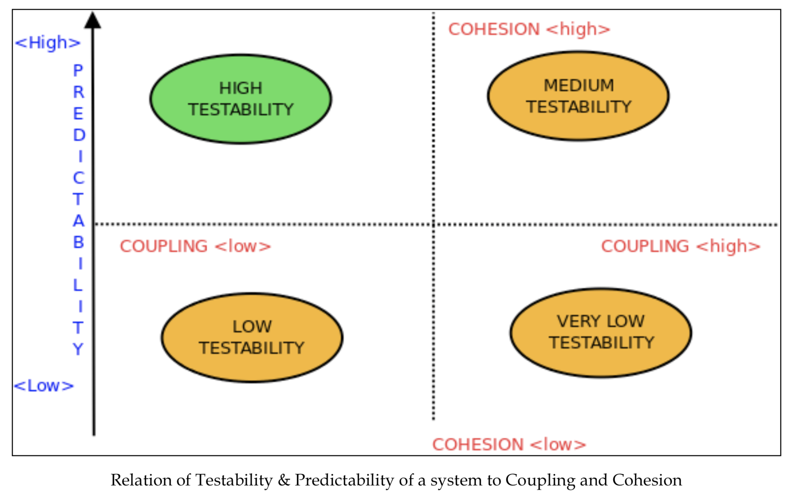
Modifiability
Coupling: elements very tightly coupled would yield to modification much lesser than a module which has a loosely coupled elements.
Cohesion: a class or module which does not define its role and responsibilities clearly would be more difficult to modify than another one which has well-defined responsibility and functionality

Slide 15
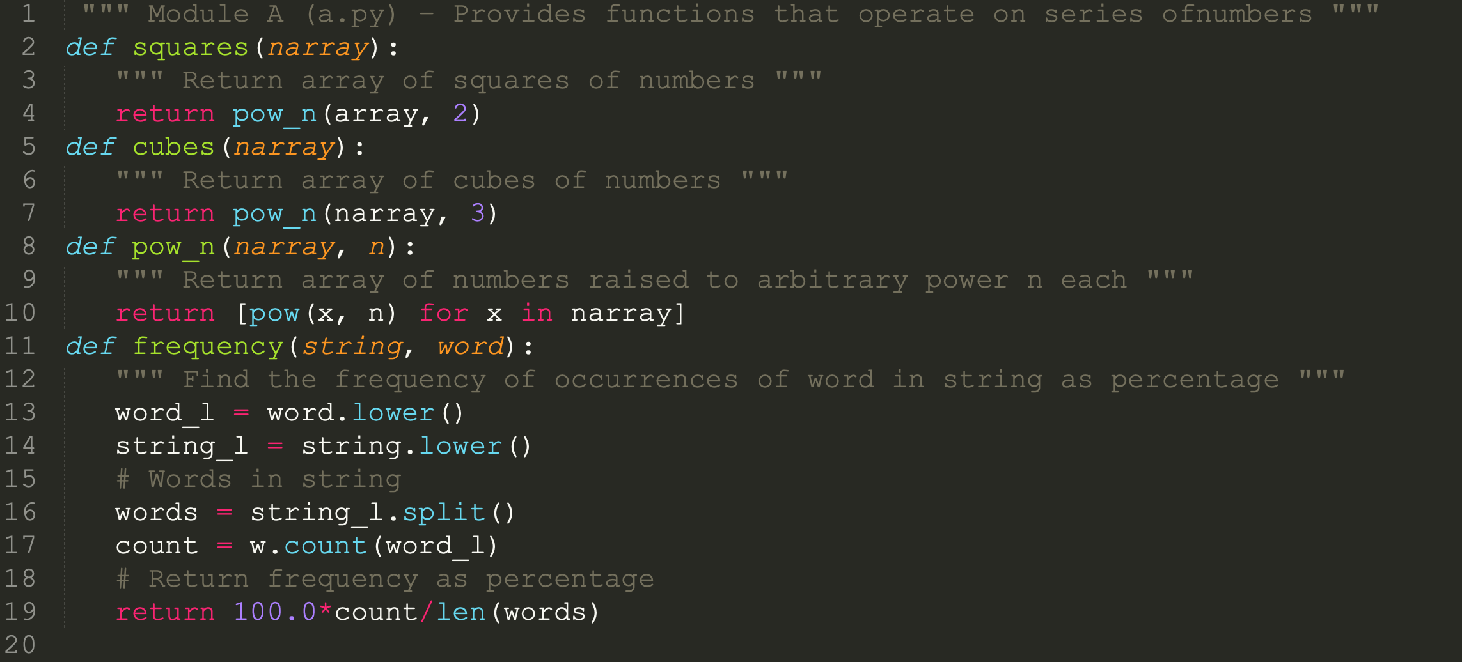
Measuring Cohesion and Coupling

Slide 16
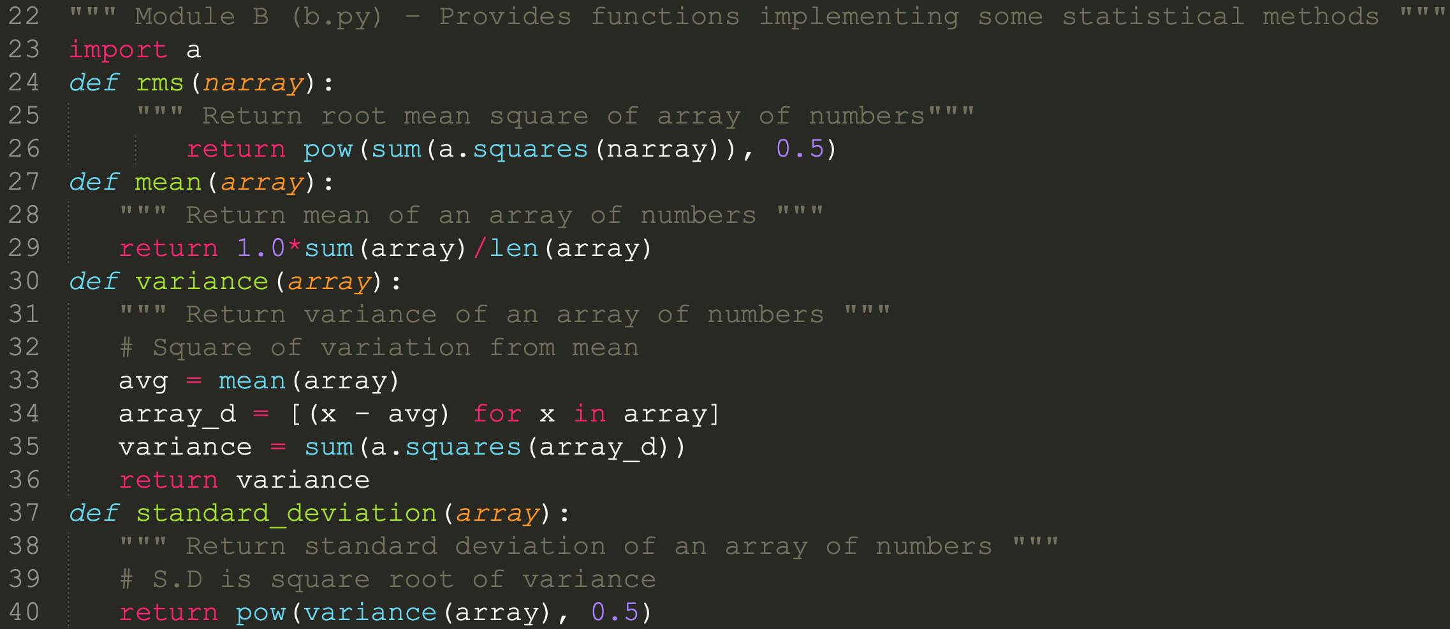
Measuring Cohesion and Coupling

Slide 17
Measuring Cohesion and Coupling
Module | Core functions | Unrelated functions | Function dependencies
B | 4 | 0 | 3 x1 = 3
A | 3 | 1 | 0
Cohesion:
Module B has four functions, all of them dealing with the core functionality. There are no unrelated functions in this module. Thus module B has 100% cohesion.
Module A has four functions, three of which are related to its core functionality, but the last one (frequency) isn't. This gives module A approximately 75% cohesion.
Coupling:
Three of module B has functions that depend on one function in module A, namely, squares. This makes module B strongly coupled to module A. coupling at function level is 75% from module B → A.
Module A doesn't depend on any functionality of module B. Module A will work independent of module B. Coupling from module A → B is zero.

Slide 18
Measuring Cohesion and Coupling
Strategies to improve:
Cohesion:
Problem: Module A has 75% cohesion. Root cause unrelated function frequency().
Solution: Move the function to another module.
Coupling:
Problem: Module B 3 function depends on A’s 1 function (B → A)
Solution: There is no 2 way coupling. even though there is strong coupling from B to A, it is good coupling. No change is required to improve modifiability of the system.

Slide 19
What is Clean code?
Definition
Source code must be:
readable & well structured
extensible
testable
Why is it important?
Code is written once, read million times!
Values
Correctness, Evolvability, Production efficiency, Continuous improvement

Slide 20
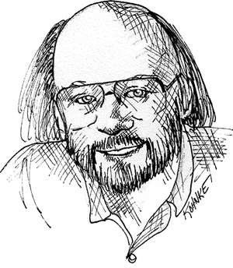
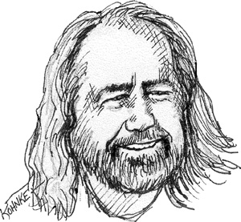
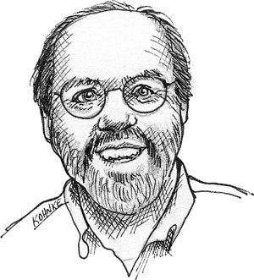
“Clean Code” ?
Bjarne Stroustrup
Inventor of C++
Grady Booch
creator of UML
Ward Cunningham
inventor of Wiki and XP
Pleasingly graceful and stylish in appearance or manner
Clean code reads like well written prose
.. each routine turns out to be pretty much what you expected
Notes:
So, what is Clean code anyway?
“Pleasingly graceful and stylish in appearance or manner” - and this guy invented C++?! Graceful and stylish..
“Clean code reads like well written prose” - Grady Booch, creator of UML. Interestingly, UML can’t be read like a prose at all.. But may be there is something in there afterall..
“.. each routine turns out to be pretty much what you expected” Ward Cunningham, inventor of Wiki.
So, clean code should not “surprise”. I can definitely relate to that. How often you open someone else’s code and go
“Wow, what is that.. This is very curious and inventive way.. But.. WHY??”
So clean code should aim not to surprise. It should be even “boring” and “predictable”. And consistent.. But more on that later

Slide 21



One does not simply start writing clean code..
Kent Beck
co-inventor of XP and TDD
Ron Jeffries
author of Extreme Programming Installed
The Boy Scouts of America
Applied to programming by Uncle Bob
First make it work,
Then make it Right,
Then make it fast and small
Run all the tests
Contains no duplicate code
Expresses all ideas...
Minimize classes and methods
Leave the campground cleaner than you found it
Notes:
First make it work,
Then make it Right,
Then make it fast and small
These are the Design rules of Kent Beck, creator and proponent of Test Driven Development
Another recipe for making clean code from Ron Jeffries, leading book author on Agile, XP and good practices:
Clean code is the one that..
Run all the tests
Contains no duplicate code
Expresses all ideas...
Minimize classes and methods
Robert C. Martin, found a very successful metaphor for writing clean code sustainably.. It is called a Boy Scout rule of development:
Leave the campground cleaner than you found it

Slide 22
Basics of clean coding
Functions are first-class objects
Small
Do one thing
One level of abstraction
Duck-typing as an interface
No setters/getters
Use more of itertools, zip, enumerate, etc.

Slide 23
Principles
I'm not a great programmer;
I'm just a good programmer with great habits.
Kent Beck

Slide 24
Principle: DRY
Don't Repeat Yourself (DRY) and Once and Only Once (OAOO) are closely related principles.
Code duplication is a problem that directly impacts maintainability. It is very undesirable to have code duplication because of its many negative consequences:
It's error prone, It's expensive, It's unreliable
Don’t Repeat Yourself!
Avoid code duplication at all cost
Proposed solution: decorators, functions, class, modules, packages

Slide 25
Decorators
import functools
def decorator(original_function):
@functools.wraps(original_function)
def inner(*args, **kwargs):
# modify original function, or add extra logic
return original_function(*args, **kwargs)
return inner

Slide 26
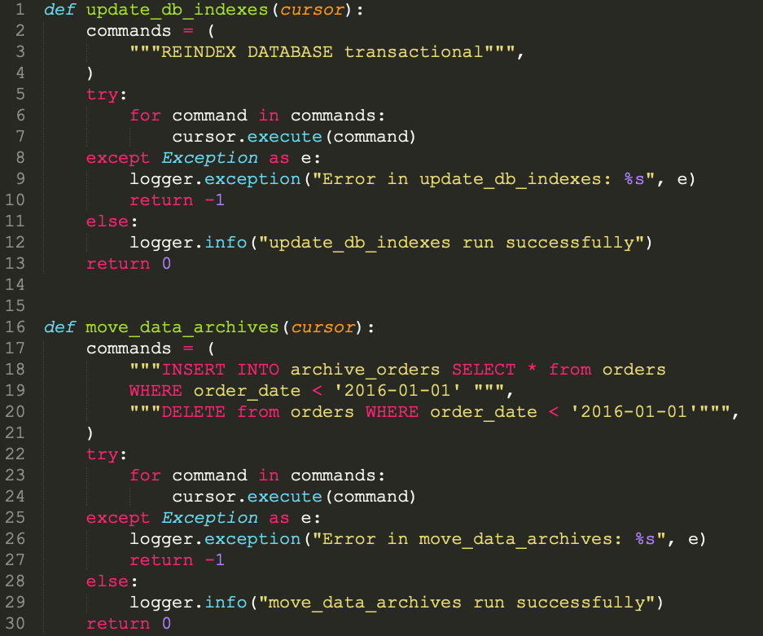
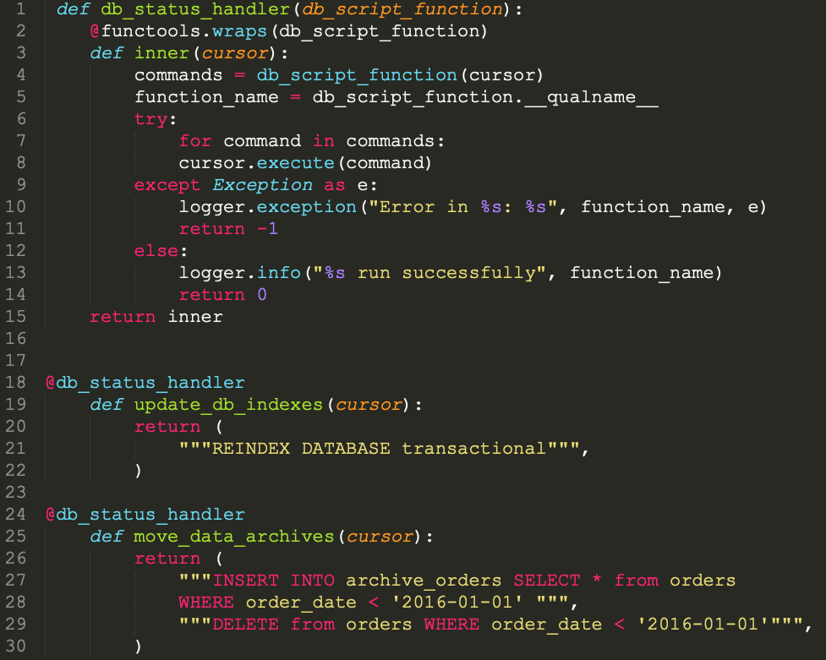
Example: Using decorator

Slide 27
Principle: KISS
KISS (stands for Keep It Simple Stupid):
when you are designing a software component, avoid over-engineering it. Ask yourself if your solution is the minimal one that fits the problem.
In terms of code, keeping it simple usually means using the smallest data structure that fits the problem. You will most likely find it in the standard library.
Remember the Zen of Python: Simple is better than complex.

Slide 28
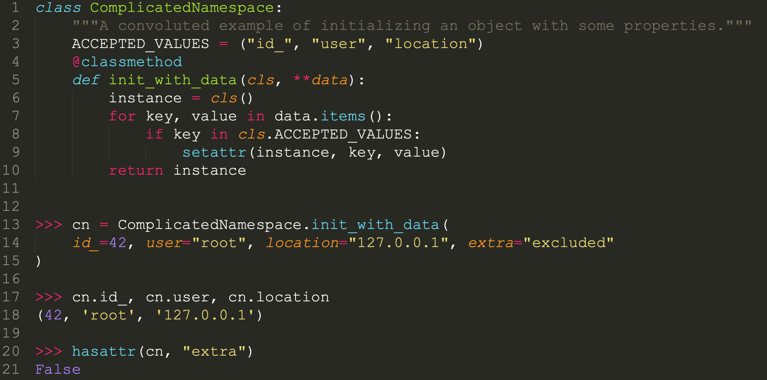
KISS Example

Slide 29
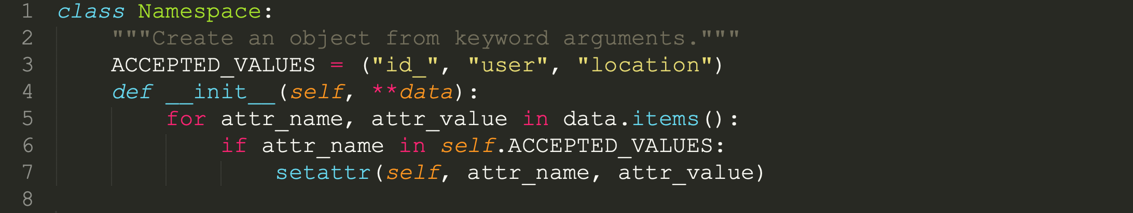
KISS Example

Slide 30
Principle: SOC
SOC (stands for Separation of Concerns)
A concern is a distinct behavior or piece of knowledge your software deals with. Concerns can range in granularity from how to calculate a square root to how payments are managed in an e-commerce system.
Remember the Zen of Python: Namespaces are one honking great idea—let’s do more of those!
We could use: Namespaces, Properties, Context managers, Magic methods

Slide 31
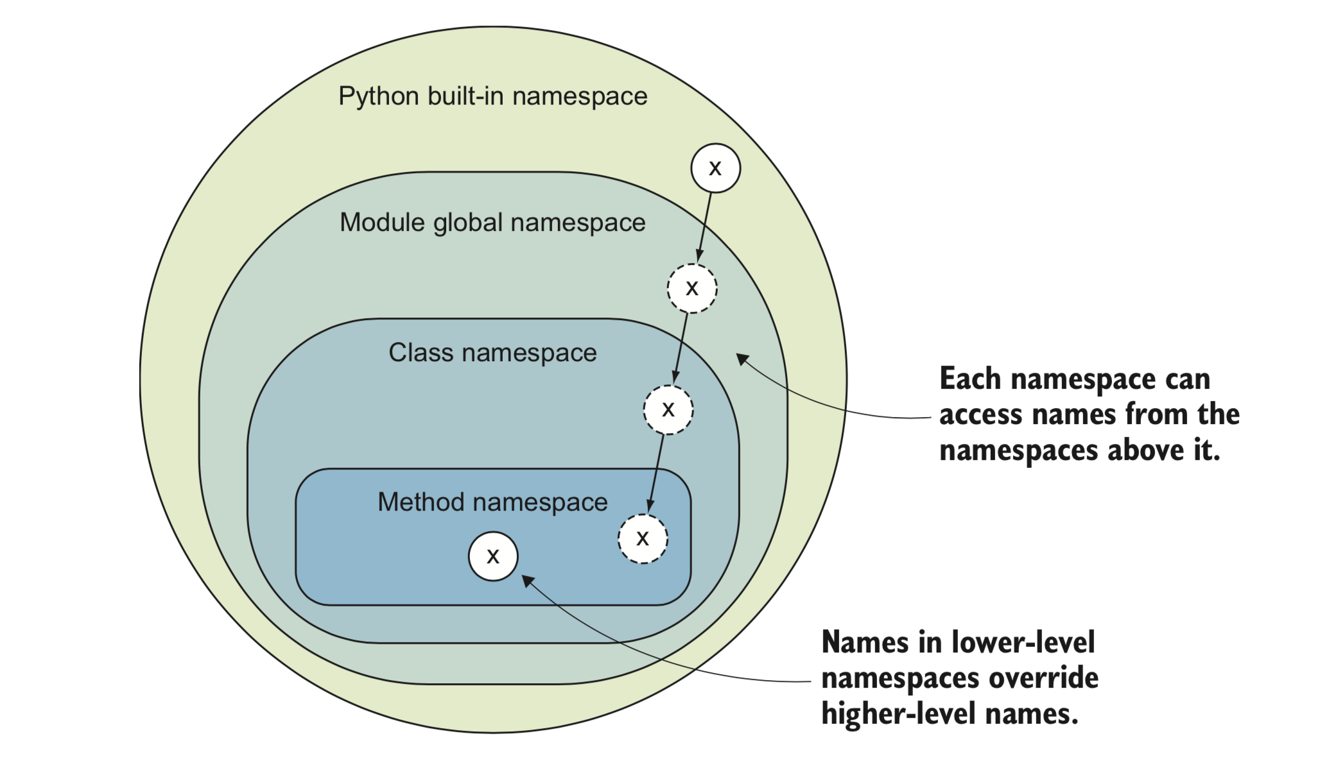
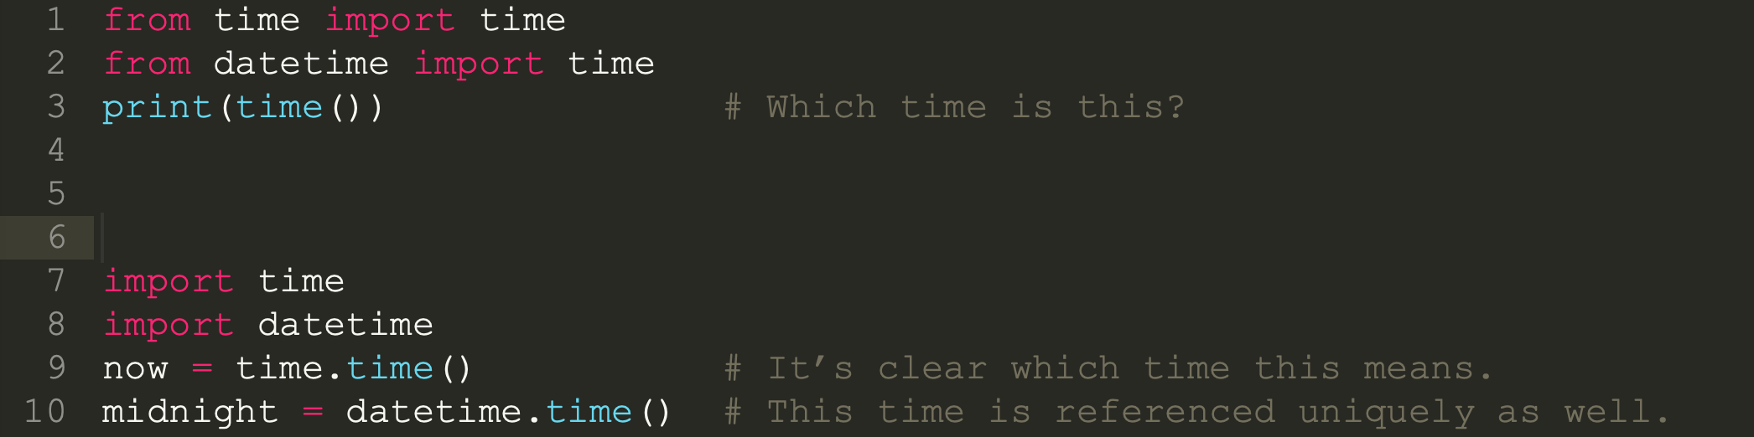
SOC
Namespaces help prevent collision

Slide 32
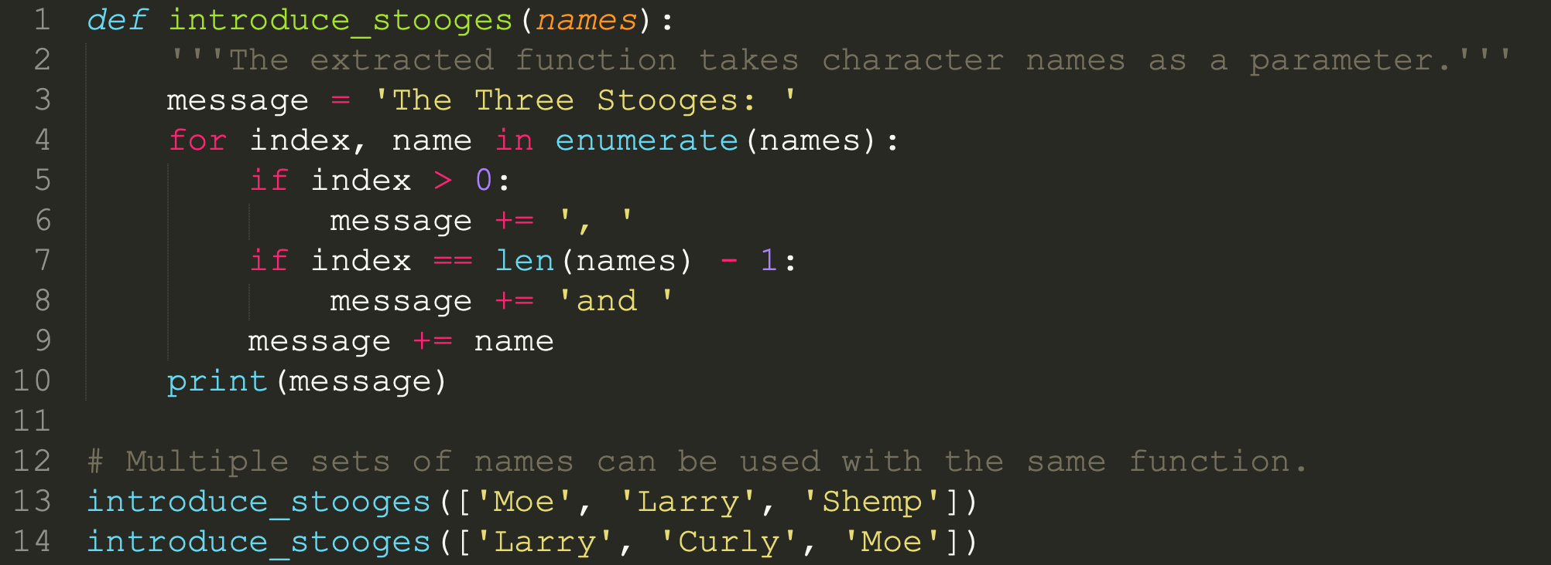
SOC
How to introduce another group? Say… The Chipmunks?

Slide 33
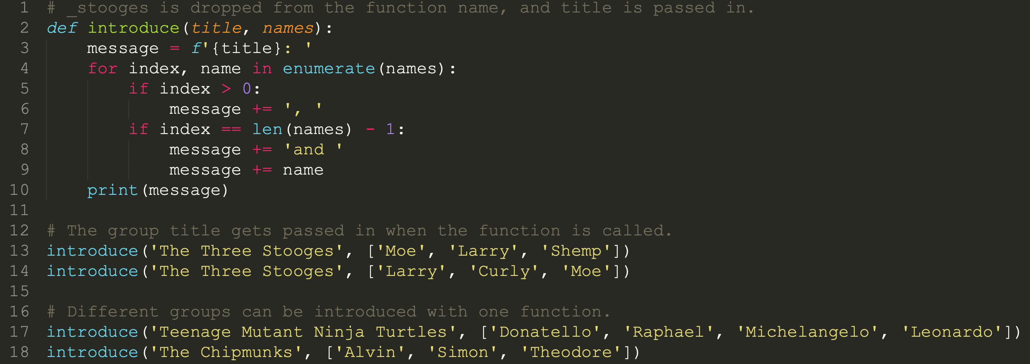
SOC

Slide 34
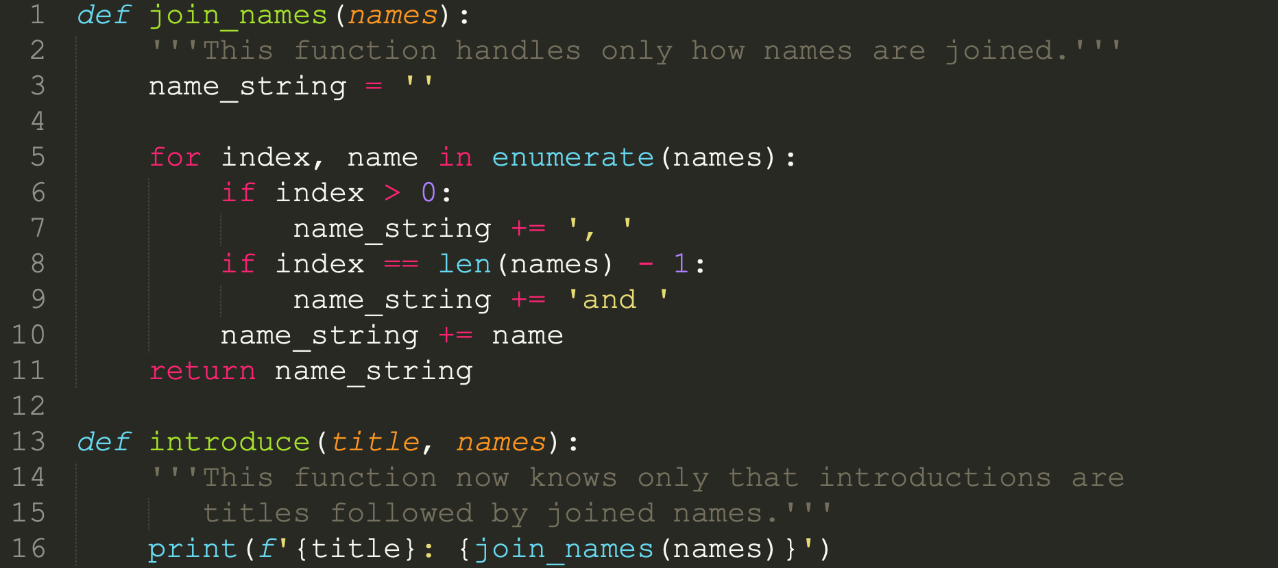
SOC
Decomposition into functions that separate concerns allows for more surgical changes.

Slide 35
Principle: SOLID
S: Single responsibility principle
The single responsibility principle (SRP) states that a software component (in general, a class) must have only one responsibility.
O: Open/closed principle
The open/closed principle (OCP) states that a module should be open to extension but closed to modification.
L: Liskov's substitution principle
Liskov's substitution principle (LSP) states that there is a series of properties that an object type must hold to preserve the reliability of its design.
I: Interface segregation principle (duck typing)
The interface segregation principle (ISP) provides some guidelines for an idea that we have revisited quite repeatedly already: that interfaces should be small.
D: Dependency inversion principle
The dependency inversion principle (DIP) proposes an interesting design principle by which we protect our code by making it independent of things that are fragile, volatile, or out of our control.

Slide 36
Test: How to refactor this code?
https://replit.com/join/hpxkxrsx-sudhakarb

Slide 37
Appendix

Slide 38
Goals for Clean coding
Loose Coupling
Two classes, components or modules are coupled when at least one of them uses the other. The less these items know about each other, the looser they are coupled.
A component that is only loosely coupled to its environment can be more easily changed or replaced than a strongly coupled component.
High Cohesion
Cohesion is the degree to which elements of a whole belong together. Methods and fields in a single class and classes of a component should have high cohesion. High cohesion in classes and components results in simpler, more easily understandable code structure and design.

